Slide 1

Open Source Design opensourcedesign.net
@opensrcdesign

Slide 2


Slide 3
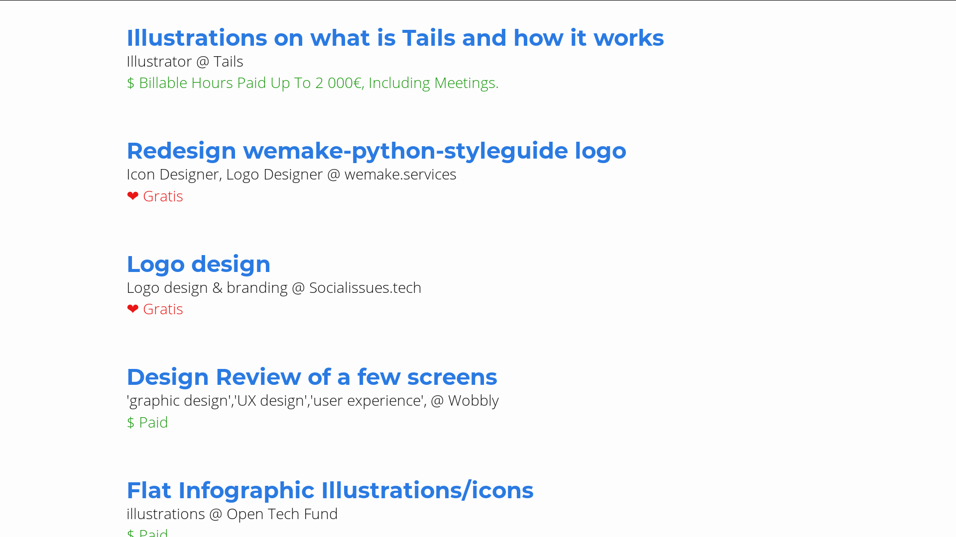

Slide 4

discourse.opensourcedesign.net

Slide 5


Slide 6


Slide 7
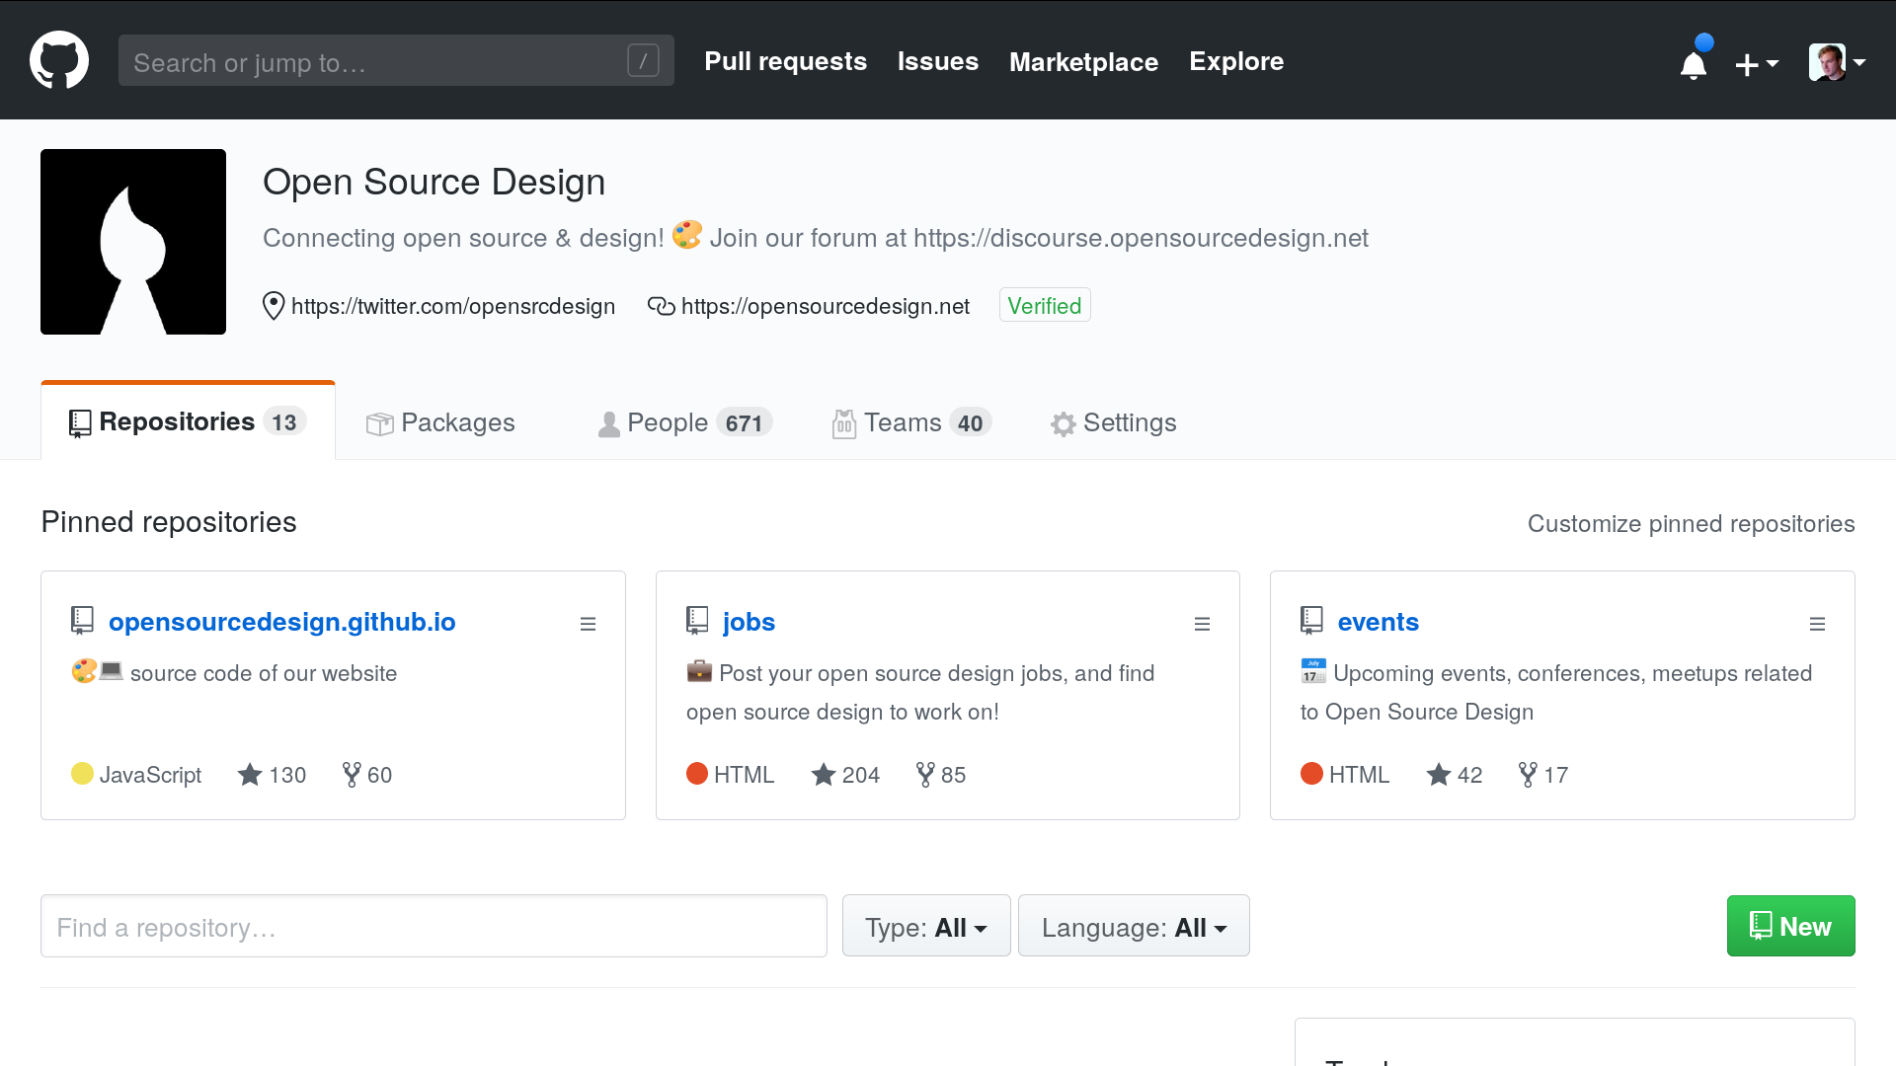

Slide 8


Slide 9
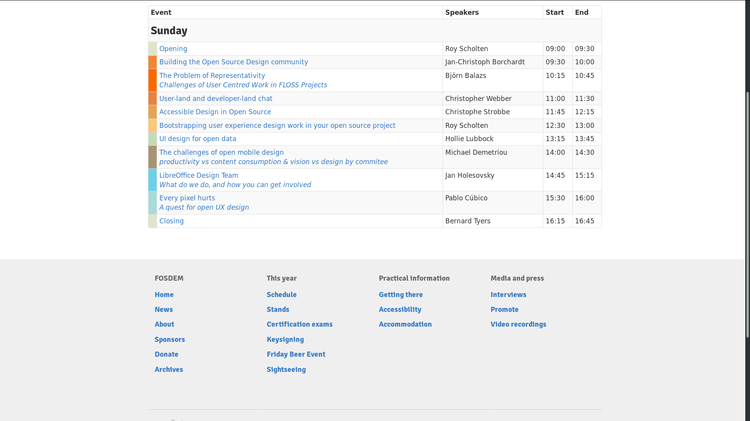
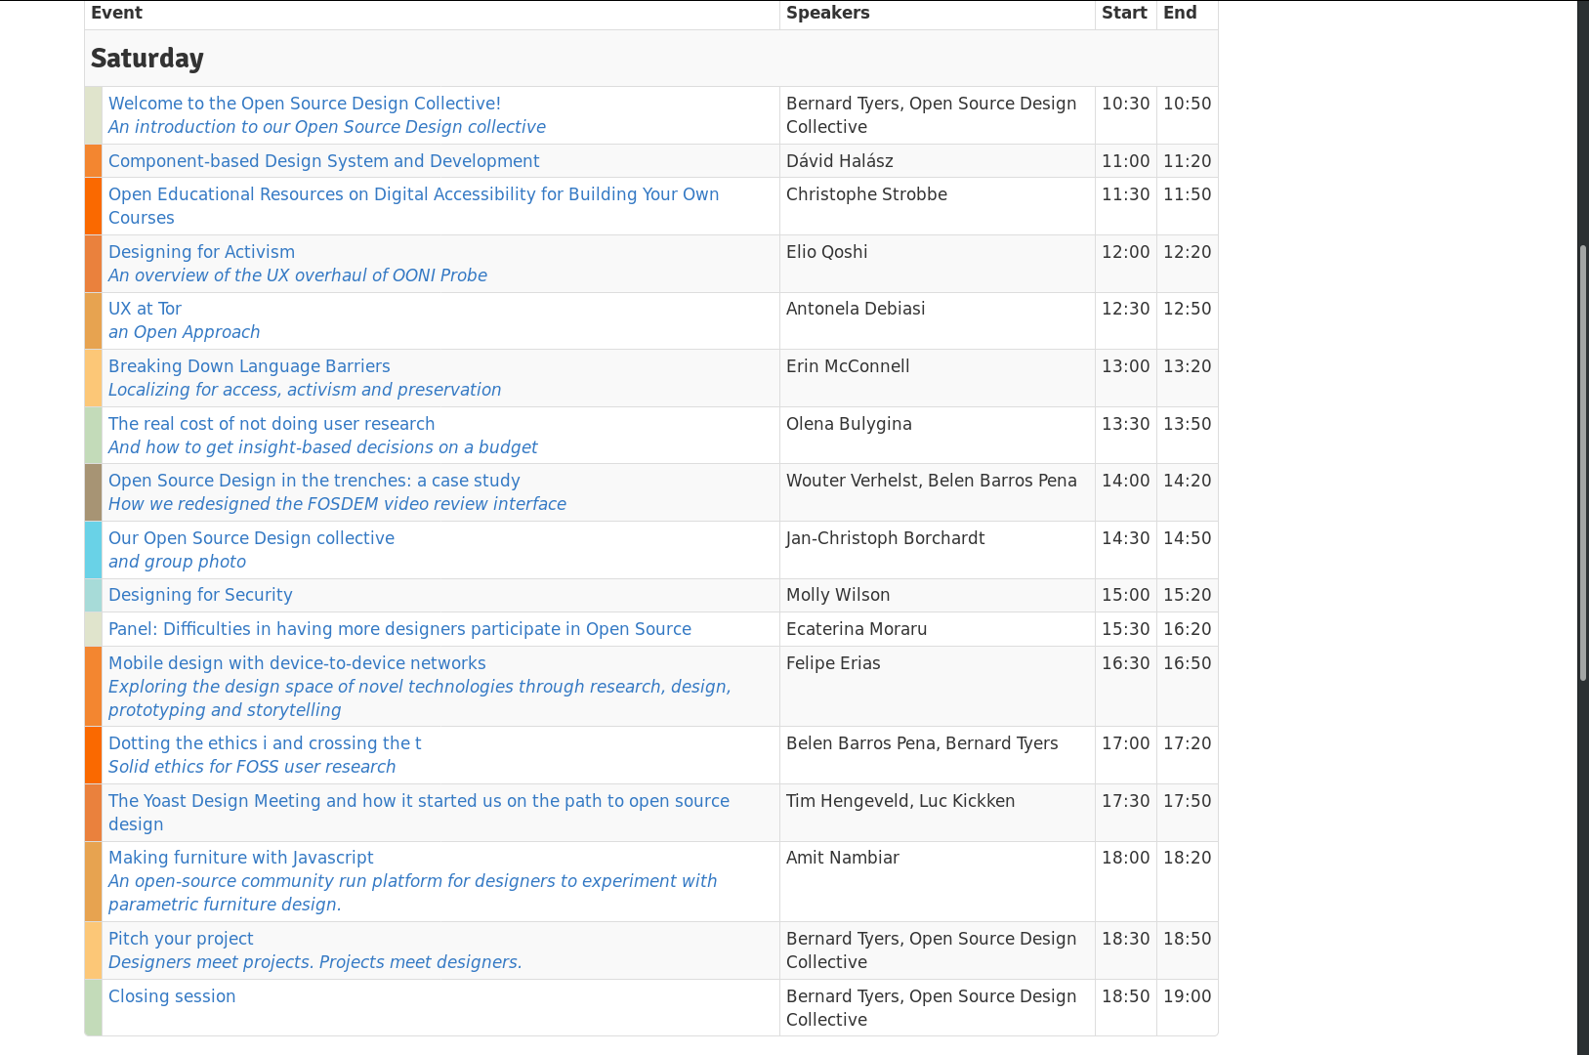
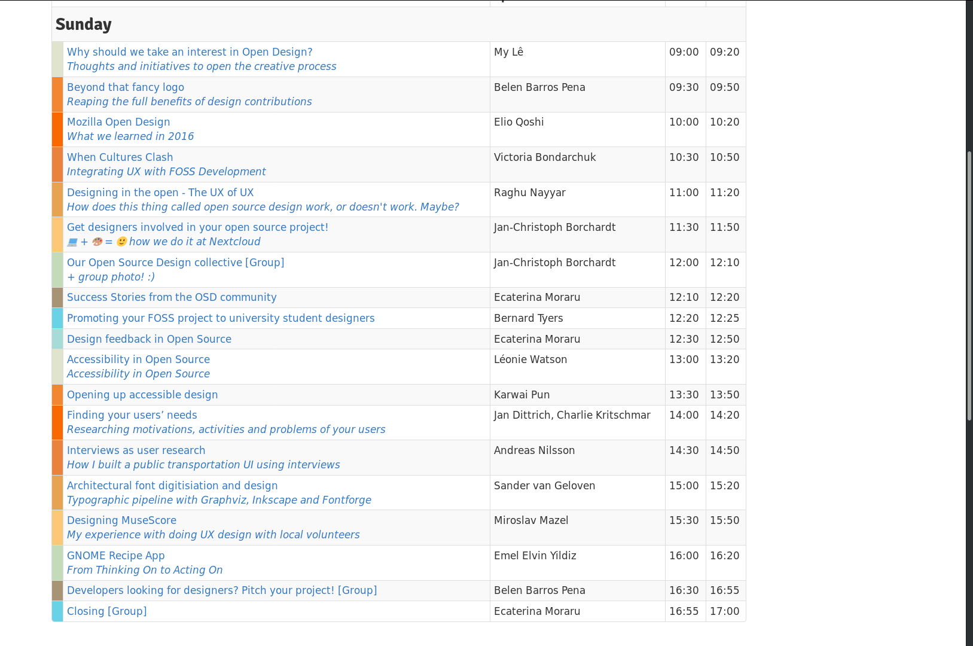
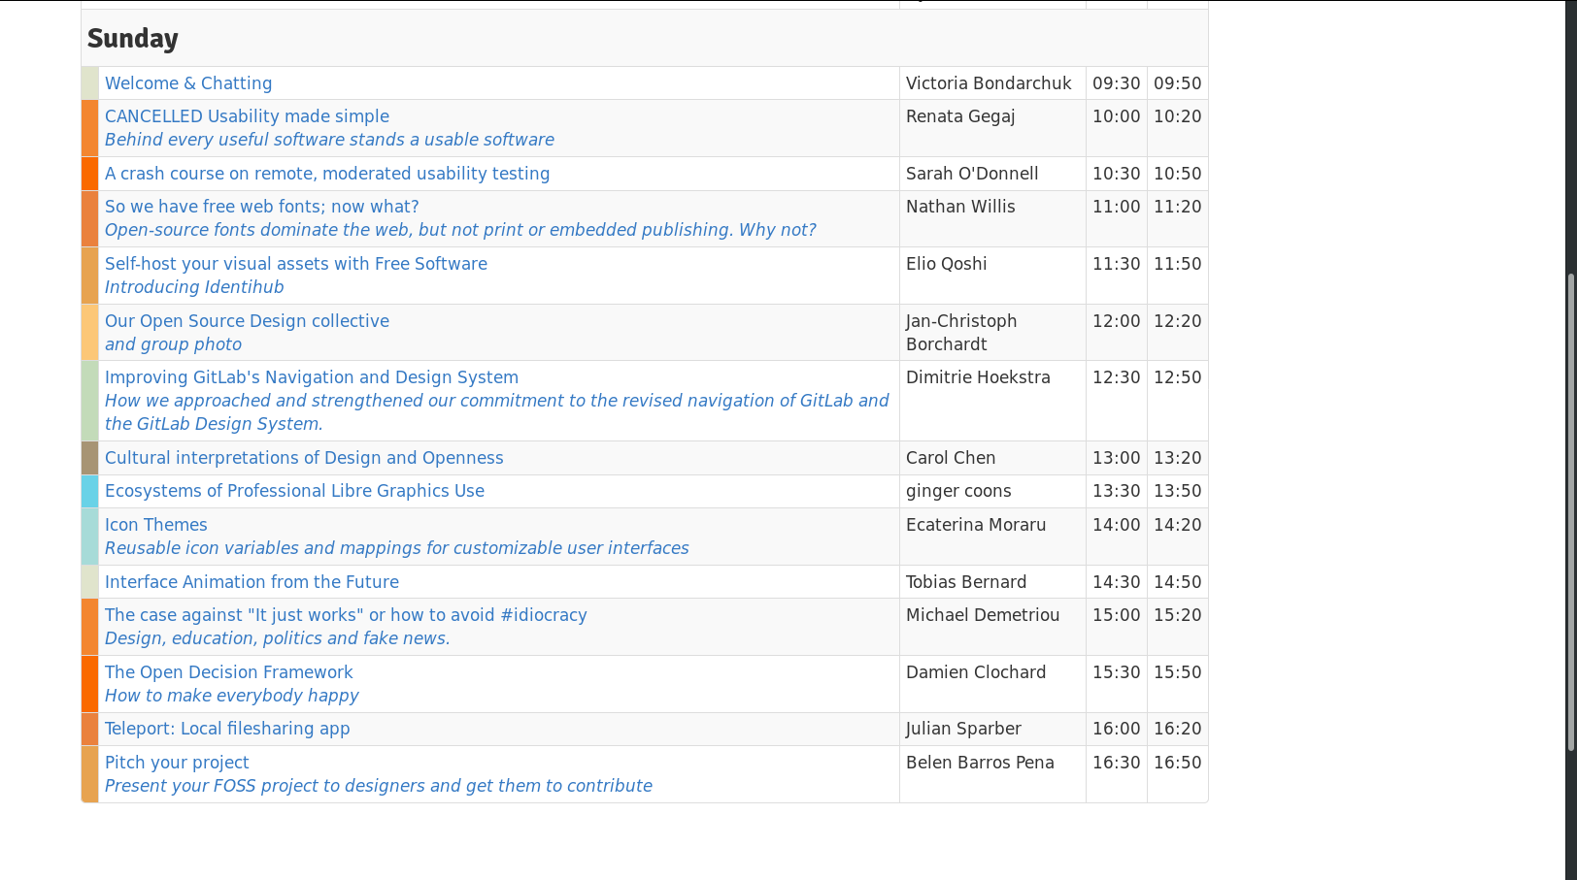
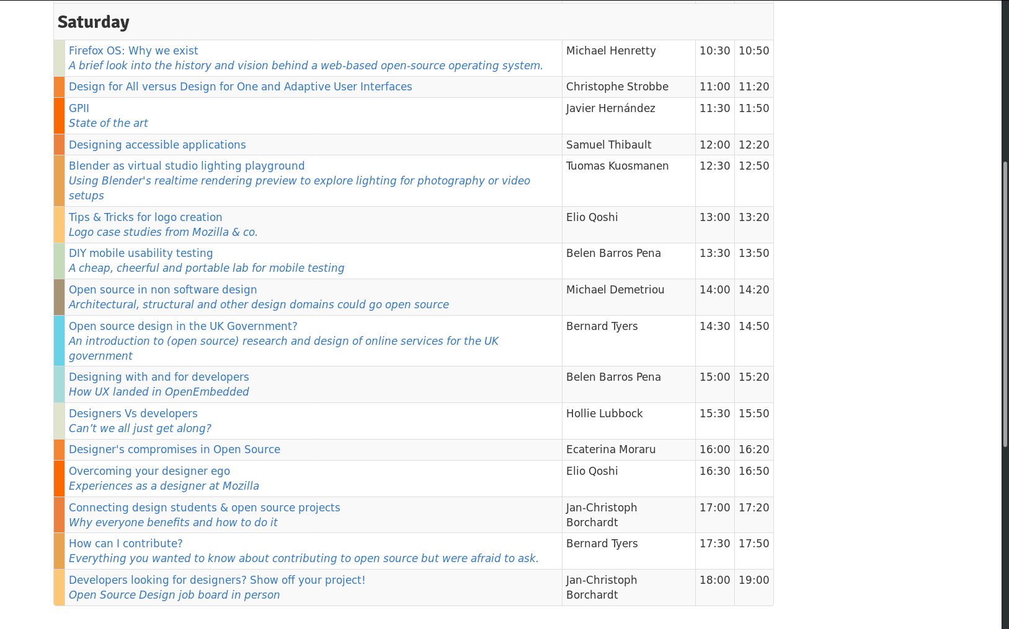
2015 2016 2017 2018 2019

Slide 10
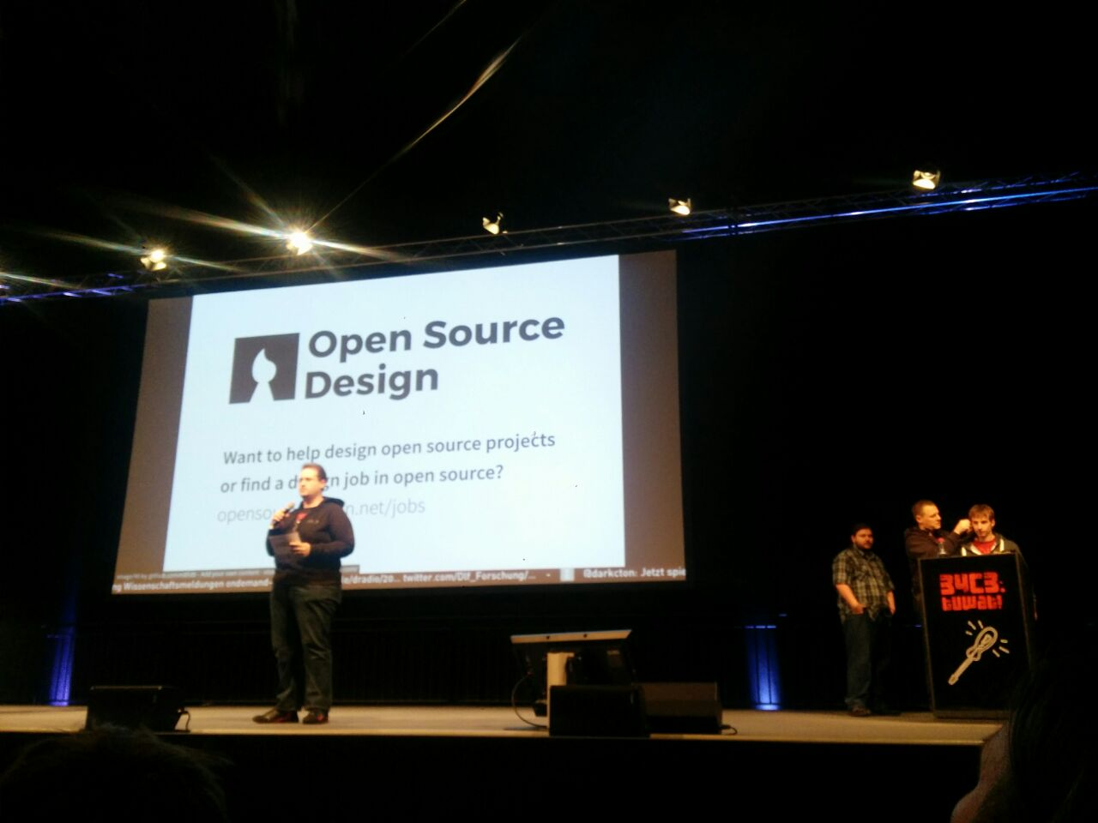
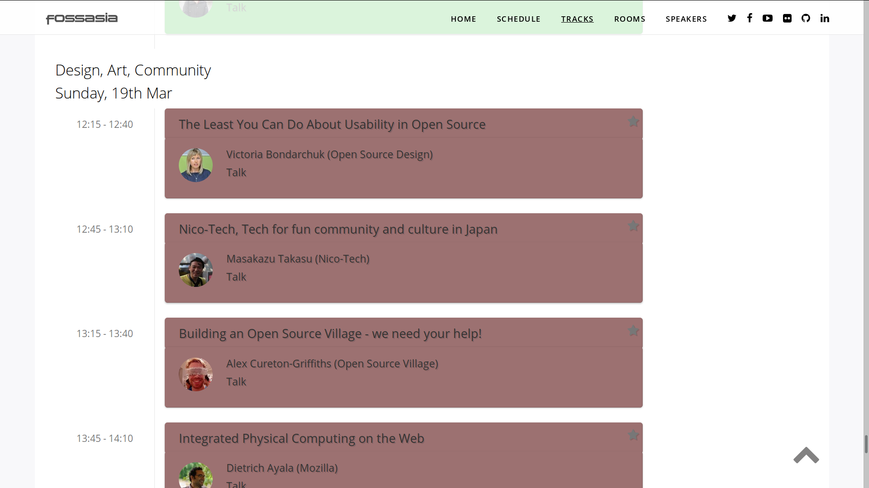

Slide 11


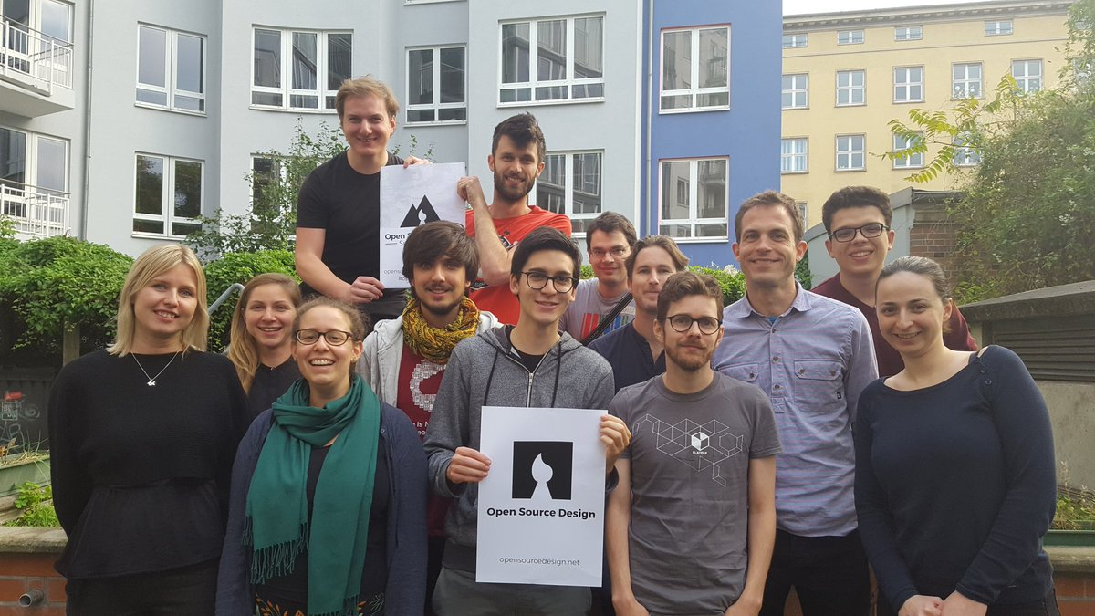

Slide 12









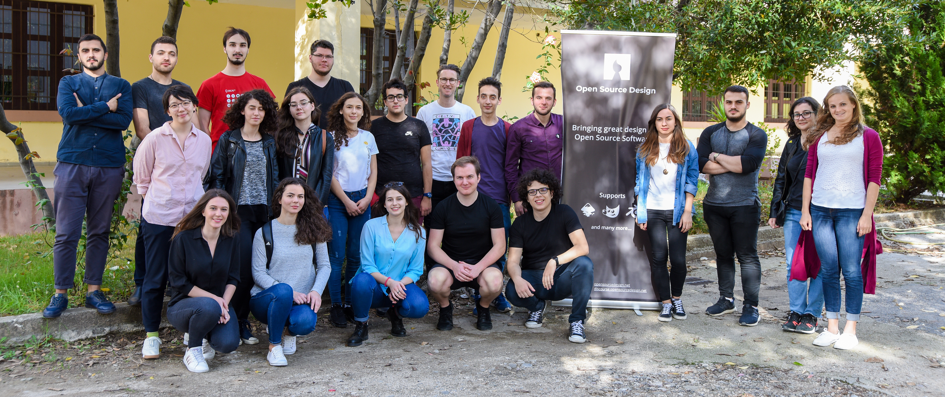

Slide 13


Slide 14


Slide 15


Slide 16
Open Source Design opensourcedesign.net
@opensrcdesign

